Slide 1
Montgomery County Office of Managed Care Solutions Reinvestment Funds
LeeAnn Moyer, MCS Administrator
Erin Lewis, MCS Community Manager
Montgomery County Board of Commissioners
Kenneth E. Lawrence, Jr., Chair
Jamila H. Winder, Vice Chair Joseph C. Gale, Commissioner
Office of Managed Care Solutions

Slide 2
What is Reinvestment?
Reinvestment is an opportunity for the County to use unspent HealthChoices (Medical Assistance) dollars in the calendar year requiring approval by the State.
Provides financial incentive to reward thoughtful and responsible use of funds.
Putting money back into and strengthening the behavioral health system.
Funds can be spent on:
Start-up costs for “in plan” services
Developing services in addition to “in plan” options
Renovation of property to support expansion or development of a service
Develop evidence based practice
Test innovative treatment as a pilot

Slide 3
Deciding how to spend Reinvestment funds
Reinvestment helps improve the County’s overall comprehensive behavioral health system. A system that supports individuals with:
Mental Health experiences and treatment needs
Drug & Alcohol treatment needs
Family support structure
Planning of these funds must be done in partnership with:
Stakeholders: individuals receiving behavioral health supports and services, families (including children and adolescents), community members, Community Support Program (CSP) and other Stakeholder groups, specialty populations (aging and adults/Seniors), etc.
HHS: Program Offices such as Office of Mental Health and Office of Drug and Alcohol.

Slide 4
Deciding how to spend Reinvestment funds continued
Data drives the planning process:
Community Needs Assessment Documents
Gaps in Care
HHS Strategic Plan
Quality Indicators within the HealthChoices Program
Annual CSP Mental Health Needs Assessment Survey
A Reinvestment Plan is written and submitted to OMHSAS for approval after the MCS Board has reviewed and approved.

Slide 5
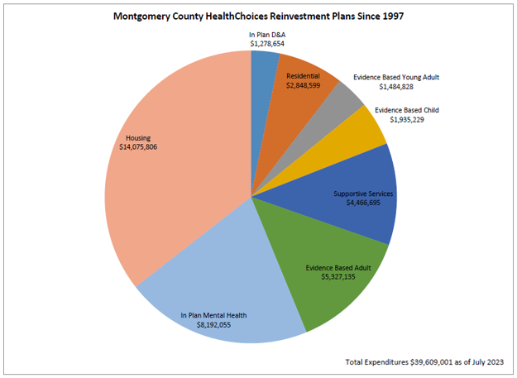
Reinvestment Funds Distribution

Slide 6
What is our Largest Investment?
Housing

Slide 7
Use of Reinvestment Funds for Housing
Capital Funds
Funds that go to creating development. This is a partnership with other agencies. The benefit is this creates long term housing.
Examples: Senior Affordable Housing, Disabled Housing, 55+
Rental Assistance
Subsidized housing: system that provides assistance to reduce cost of housing.
Supportive Services/Program Management
Administrative oversight to oversee the process and assist when necessary.
Contingency
Unforeseen and temporary financial setbacks, acting as a bridge for stability.
Example: Assistance with past due bills relating to housing needs, damage, infestations, etc.

Slide 8
Recommendation of Reinvestment Plans
If you have any suggestions,
please feel free to contact:
Erin Lewis
Erin.Lewis@montgomerycountypa.gov

